Slide 1
Teach Like a Champion
Instructor Opening meeting

Slide 2
Objectives
IWBAT understand the resources available to them through CELT
IWBAT save-the-date for faculty retreat
IWBAT understand the importance of attendance
IWBAT understand the importance of culture and standards with 1st generation students
IWBAT meet a fellow instructor and make them their near-peer mentor
IWBAT understand the function of the DYF Blackboard Organization

Slide 3
Meet CELT
IWBAT understand the resources available to them through CELT

Slide 4
Meet CELT
The Center for Excellence in Learning and Teaching (CELT) at Concordia University develops faculty for excellence in teaching in the face-to-face and blended learning environments, including the meaningful connection between faith and learning, to support Concordia’s mission of Christ centered Lutheran higher education. CELT encourages self-reflective, scholarly teaching among Concordia faculty through consultation, collaboration, and community.

Slide 5
MEET CELT
How They Work with Faculty
Faith & Learning
Enhancing Teaching with Technology (Blackboard)
Nine Principles of Good Practice in Teaching and Learning
Self-Reflective, Scholarly Teaching
Scholarship of Teaching and Learning (SoTL)
Recognizing Teaching Excellence
Peer Evaluation of Teaching

Slide 6
Meet CELT
Dr. Elizabeth Evans, Director Phone Number: 262 243 4283 Email Address: elizabeth.evans@cuw.edu
Justin Frisque, Educational Technologies Support Technician Phone Number: 262 243 4270 Email Address: justin.frisque@cuw.edu
Susan Gallanis, Instructional Development Specialist Phone Number: 262 243 2007 Email Address: susan.gallanis@cuw.edu
Susan Nusser, Blended Learning Development Specialist (Part Time) Phone Number: 262 243 2082 Email Address: susan.nusser@cuw.edu

Slide 7
MEET CELT
BlackBoard
Accessible via concordia.blackboard.com
Allows you to record grades so students can track their progress
Has capabilities for being able to assess students
May be a good vehicle for allowing students to access work and hold them accountable for what is discussed prior to and after class
DYF will have an organization live in February with instructor resources
For assistance with accessing Blackboard please reach out to Alea

Slide 8
MEET CELT
CELT Has 9 practices for good teaching
DYF wants to highlight three this semester

Slide 9
MEET CELT
1
Good Practice Communicates High Expectations
Expect more and you will get it. High expectations are important for everyone—for the poorly prepared, for those unwilling to exert themselves, and for the bright and well motivated. Expecting students to perform well can become a self-fulfilling prophecy when instructors uphold high expectations of themselves.

Slide 10
MEET CELT
What do high expectations look like in your lecture?!
How do you communicate those expectations?
How do you reinforce those expectations?
2 min to reflect… let’s share…

Slide 11
MEET CELT
If we were to make a goal list collectively, what are the expectations that we’d want to agree to collectively as it relates to high expectations?

Slide 12
Meet CELT
2
Good Practice Gives Prompt Feedback
Knowing what you know and don’t know focuses learning. Students need appropriate feedback on performance to benefit from courses. In getting started, students need help in assessing existing knowledge and competence. In classes, students need frequent opportunities to perform and receive suggestions for improvement. At various points during college, and at the end, students need chances to reflect on what they have learned, what they still need to know, and how to assess themselves.

Slide 13
MEET CELT
What does feedback look like in your lecture?!
How do you communicate affirmations vs. areas of challenge?
How do you reinforce students meeting rigor and real world connections?
2 min to reflect… let’s share…

Slide 14
MEET CELT
If we were to make a goal list collectively, what are the expectations that we’d want to agree to collectively as it relates to prompt feedback?

Slide 15
Meet CELT
3
Good Practice Respects Diverse Talents and Ways of Learning
There are many roads to learning. People bring different talents and styles of learning to college. Students rich in hands-on experiences may not do so well with theory. Students need the opportunity to show their talents and learn in ways that work for them, and then be encouraged to learn in less familiar ways.

Slide 16
MEET CELT
What does differentiated learning look like in your lecture?!
How do you communicate to different learning styles?
How do you reinforce students meeting rigor and real world connections?
2 min to reflect… let’s share…

Slide 17
MEET CELT
If we were to make a goal list collectively, what are the expectations that we’d want to agree to collectively as it relates to prompt feedback?

Slide 18
NEED TO GET AWAY?!
IWBAT save-the-date for faculty retreat

Slide 19
NEED TO GET AWAY
Mark your calendars CUW will host a faculty retreat
Friday, July 22, 2016to Sunday, July 24, 2016
Mequon (details will follow soon)

Slide 20
RIP
IWBAT understand the importance of attendance

Slide 21
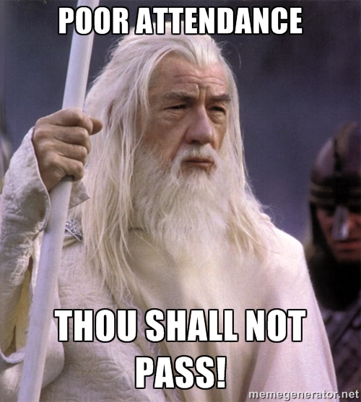
RIP

Slide 22
RIP
University policy: after a student has missed 5 classes, we drop them!
DYF: tracks attendance and we work with student to make sure they understand why they should attend vs. not attend school
Excused absences: You should be contacted along with the DYF staff (student should present a doctor’s note, supervisor’s statement, coach reach out for student athletes, etc.) They are accountable and responsible for the time and work assigned!

Slide 23
RIP
When attendance records are submitted for attendance:
Signature
Submission date to Director

Slide 24
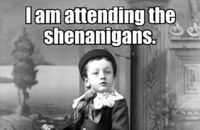
RIP

Slide 25
RIP
Why is the last date a student attends your class important…
Financial Aid
Accounts Payable
W vs WF
W→ Student messages DYF Staff and says I no longer want to attend
WF→ Student’s attendance prohibited participation in class (i.e. hitting 5 day mark, or remaining in the class with excessive absences [non excused] and fail the class) #WhatYouMissed10days?!

Slide 26
RIP

Slide 27
Love & Logic
IWBAT understand the importance of culture and standards with 1st generation students

Slide 28
Love and Logic
https://www.youtube.com/watch?v=FyJRiCWy7xo

Slide 29
Love and Logic
So how do you work with someone who has not been packaged with everything that makes them ready for a college environment?!
Increase standard share the why!
Guiding to solve own problem | Students learn they are capable of solving problems without making an excuses. | Teachers act like a consultant with students. Empathizing with them, understanding their feelings, but not rescuing them from their problems or bad choices.

Slide 30
Love and Logic
There are five steps to help students solve problems on their own:
a) Provide a strong dose of empathy.
b) Hand the problem back in a caring way.
c) Ask permission to share some solutions and provide choices.
d) Help the student evaluate the potential consequences of each choice.
e) Allow the student to either solve or not solve the problem, while you stand firm in your class expectations on rigor and performance

Slide 31
A Word From Our Sponsor
https://www.youtube.com/watch?v=w-HYZv6HzAs&list=PLqif4VWBMOZd1gu4VDlSWWlYfo7uwo_Ae&index=2

Slide 32
Student/Instructor Meet up
After a student/instructor meet and greet, we’ll convene back for 20 more minutes!

Slide 33
Love and Logic
DEBRIEF:
What did you observe your color to be from the assessment vs. the students you met?
How does that dynamic positively affect or challenge the dynamics of a lecture?
What did you learn about yourself and where you’d like to grow as an instructor?
6 minute time limit!

Slide 34
Love and Logic
Tutoring
Push for better student learning outcomes has been asking students to take the initiative to reach out and request tutoring
Director Hall has paperwork for being compensated for that time if you make that time for students outside of class

Slide 35
Semester Buddies!!!
IWBAT meet a fellow instructor and make them their near-peer mentor

Slide 36
Semester Buddies
Instructor Challenge: Friend someone you do not know! Schedule time to meet up once a month!
Instructor social is scheduled at Starbucks Thursday May 5th!!! 1:30pm-2:30pm (can you say buddy bowl?!)

Slide 37
Semester Buddies
Teams of two (rules… SOMEONE NEW!!!)
Type them here:
Example: Alea Cross- Carl Hunt

Slide 38
Semester Buddies
Professor Meet Ups
We hope to see you there!
Milwaukee Art Museum
MAM After Dark: Fri, Feb 19, 8 PM–MIDNIGHT cost 12.00 at the door
Milwaukee Rep
August Wilson’s Fences: Tickets 21.00 turned in by Thursday, March 17th for Wednesday, May 4th 6:30pm -9:30pm (talk back with the cast)

